Slide 1




RIVER REVERSALS AND THE METABOLIC REGIMES OF FLORIDA’S SPRINGS
Samantha T. Howley, Yuseung Shin, Paul Donsky, Dr. Matthew J. Cohen
School of Natural Resources and Environment
University of Florida | IFAS, Gainesville, FL 32611
Samantha T. Howley¹, Matt Cohen²
School of Natural Resources and Environment (1)
School of Natural Forest, Fisheries, and Geomatic Sciences (2)
University of Florida | IFAS, Gainesville, FL 32611

Slide 2
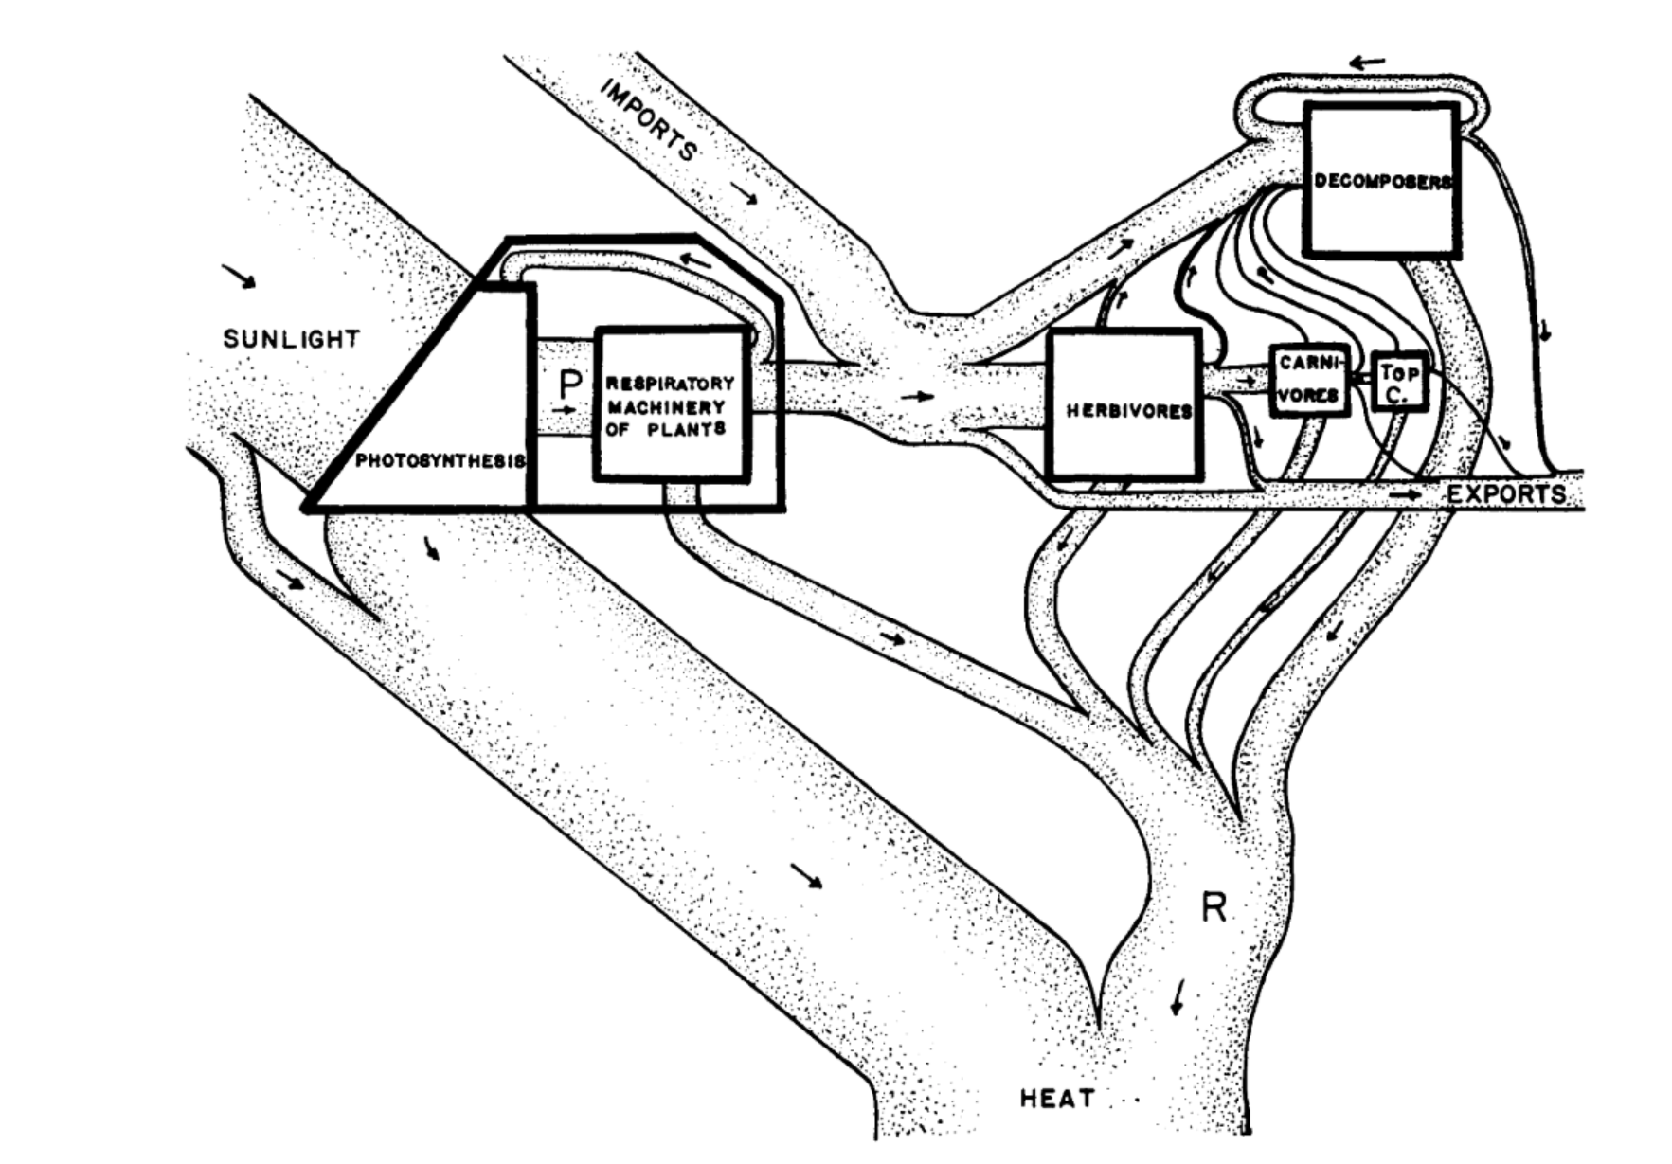
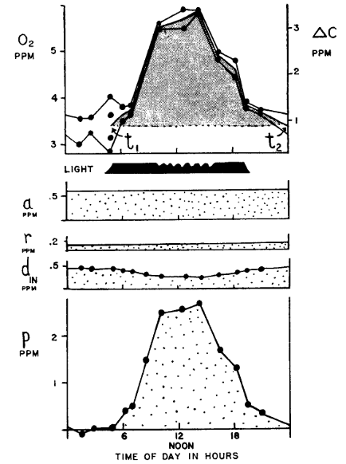
What is a metabolic regime?
Stream metabolism: the energy flow through flowing waters via ER and GPP.
Ecosystem Respiration (ER): total respiration; consuming oxygen.
Gross Primary Productivity (GPP): total photosynthesis; producing oxygen.
Net Ecosystem Productivity (NEP) = GPP-ER
Primary Production in Flowing Waters, HT Odum, 1956
Notes:
Before we jump in, the metabolic regime of flowing waters refers to a stream or rivers productivity over a study period.
But it’s first found by modeling a stream’s daily metabolism
Stream metabolism is the energy flow through out an ecosystem via
gross primary productivity, GPP, organisms producing oxygen
Ecosystem respiration, ER, consuming oxygen
It is like a Russian doll. The metabolic regime is the over arching productivity, stream metabolism is a day snapshot, and ER & GPP are the hourly details.
In this slide, I have emphasized the consumption and production of O because stream metabolism is estimated by tracking changes in DO
These photos are from the classic, stream-metabolism paper, the Primary Production of Flowing Waters where HT Odum researched the metabolic regime of… North Florida’s springs ☺

Slide 4










Influences on stream metabolism
Temperature
Canopy Cover
Temperature
Acuña et al., 2004;
Fuss & Smock, 1996;
Meyer & Edwards, 1990;
Mulholland et al., 2001;
Shen et al., 2015;
Sinsabaugh, 1997
Seasons
Disturbance
N-P
Recalcitrance
Depth (stage)
Nutrients
Bernhardt et al., 2019;
Hall et al., 2015;
Julian et al., 2008;
LeRoy Poff et al., 1997
Biomass density
Flow Velocity
Notes:
Stream metabolism, and stream metabolic regime, is dictated by a multitude of factors that I have listed above such as canopy cover, disturbance, and nutrient concentrations but in my opinion, light, OM quality/quantity, and flow are the majoring determining factors. If there is no light- there's no photosynthesis, OM is influential for ER, and flow velocity determines the export of solutes and biomass density.

Slide 5

Welcome to North Florida’s Springs, “nature’s chemostats”
Odum, 1956; 1957
Notes:
Which brings me to my study sites, North Florida springs! A terrible place to do fieldwork!
Due to the upper Floridian aquifer (the UFA) discharging groundwater to the springs at a near constant rate and at a near constat temp of 73 degrees F year-round, FL’s springs have some of the clearest, most productive waters in the world
When HT Odum studied N FL springs, specifically Ichetucknee and Silver river, he described chemostatic, fast flowing, clear, productive, and biodiverse reaches.

Slide 6
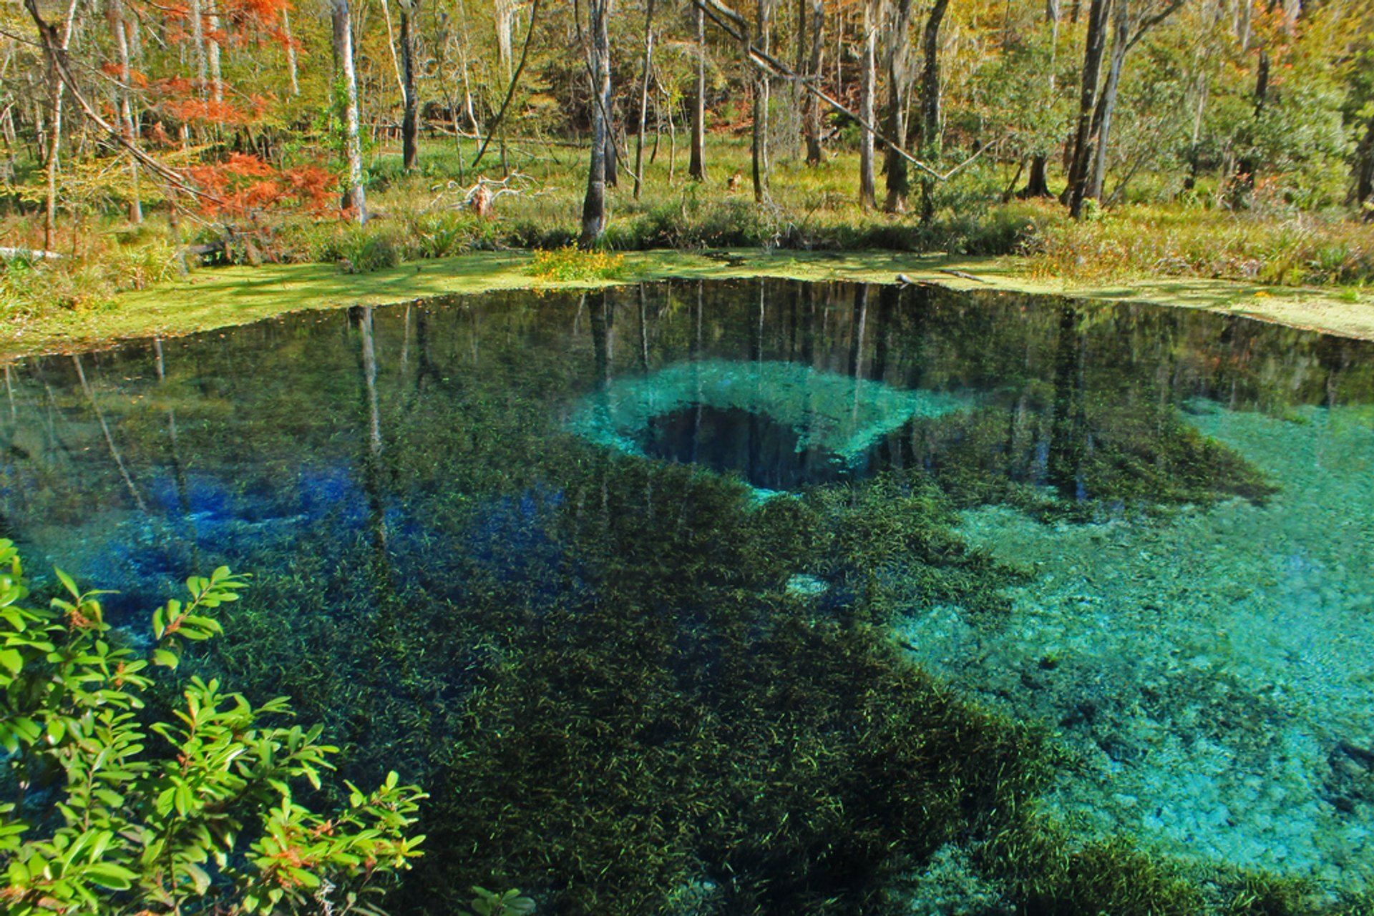
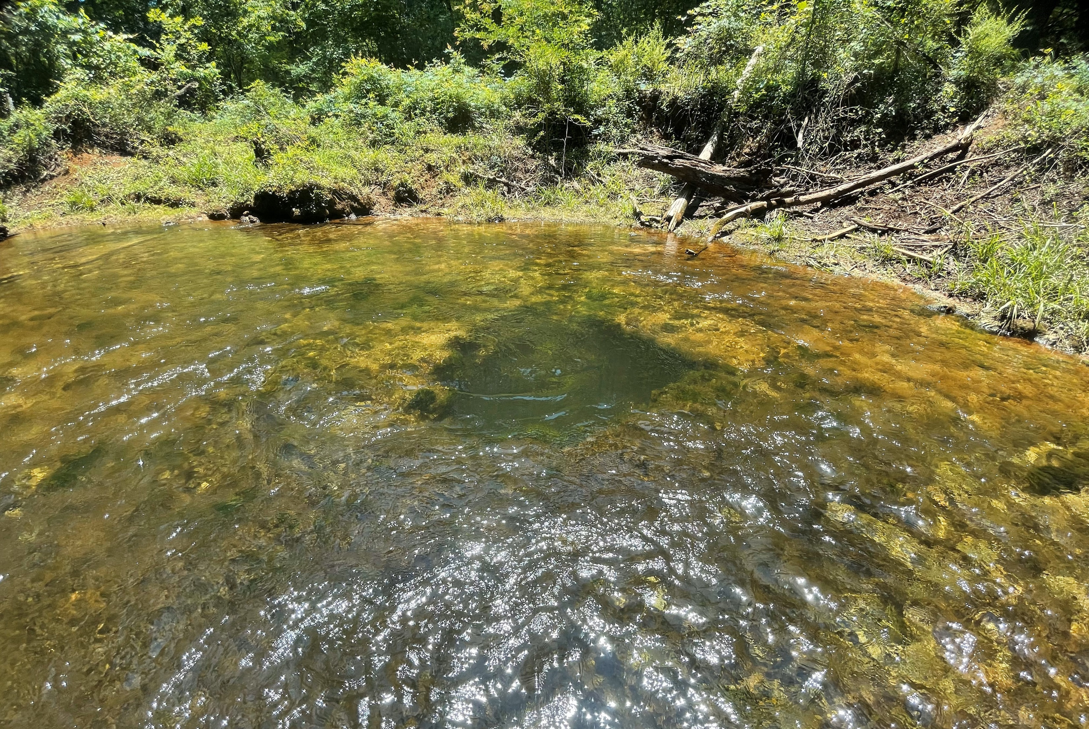
…but they don’t all look like that…
Ichetucknee Blue Hole
Allen Mill Pond
Notes:
An although that is true for Ichetucknee and Silver River, that does not apply to all N Fl springs. Most reaches are much shorter (~500m), and their water is more green than blue

Slide 7


…nor are they all chemostatic…
Gilchrist Blue Springs
Notes:
And all springs aren’t chemostatic. Yes, N FL springs don’t experience drought, but they do experience inverted floods.

Slide 8





Spring-run Flood Disturbances:
River reversals (inverted floods)
River Reversals (RR)
High stage events (h_{h})
Brownout (h_{b})
Flow reversal (h_{rev})
Increasing Disturbance Magnitude
Stage increases
Flow slows
No river influence
Water clarity maintained
Stage increases
Flow seems to halt
River influence
Degraded water clarity
Two end members mixing
Stage increase
Flow reverses
River influence
Degraded water quality
An alien end member displacing the source water
Hensley et al. 2017
Normal (h_{n})
Notes:
Most of Florida’s springs discharge into a downstream blackwater river.
Spring vents are located at higher elevation with the river-spring confluence at lower elevation.
After prolonged precipitation (conditions that would cause flooding), the river’s water level will rise, minimizing the elevation difference between the spring and the river
In best case scenario, the river will block or hinder spring discharge.
In the worst-case scenario, an inverted-flood happens, meaning, the river’s elevation can even exceed the springs causing the river to flow into the springs.
These flood distubances vary in severity…
A high stage event whenthe river acts like dam. Spring discharge is inhibited causing water to accumulates and stage to increase.
A brownout occurs when the river elevation exceeds the spring-run. River water will enter and mix with spring water.
For flow reversals, the river exceeds the spring vent and will flow into the run, displacing spring water. In this situation, the headwaters will have switched
There are some key differences between each flood type
All experience elevated stage
High stage have slowed flow and maintain water clarity
Brownouts have halted flow and reduced water clarity
Flow reversals have slow, backwards velocity and super reduced water clarity. Its 100% river water.
Here is an example…

Slide 9
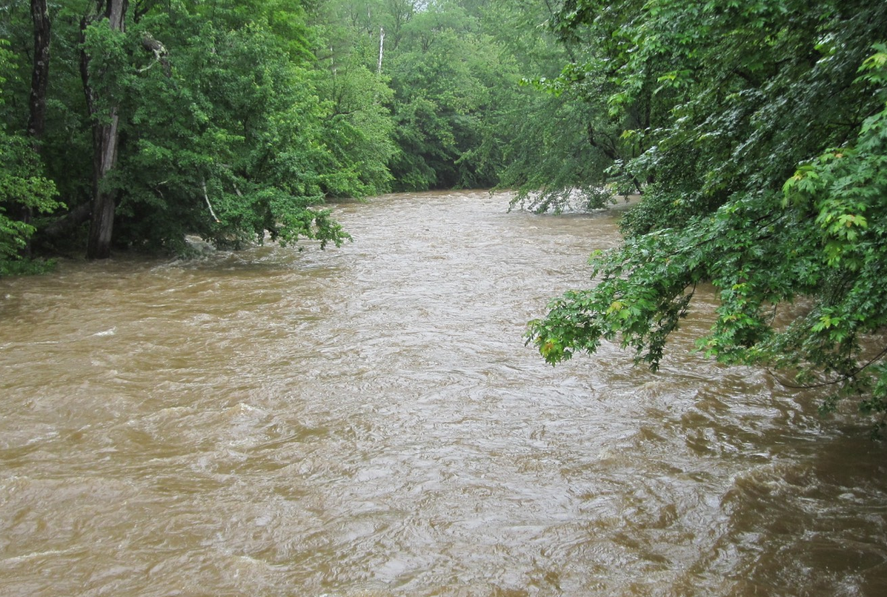




Spring-runs do not experience bed scour during floods.
Bed Scour
Gilchrist Blue Springs
Notes:
Stream floods and river reversals are similar. They both…
Increase stage
Reduced clarity
But springs do not experience bed scour
For typical stream floods, fast-flowing flood-waters causes bed scour, the physical removal of a streams benthic material
During a river reversal, flow is diminished so there is no bed scour. The benthos is retained but under meters of blackwater

Slide 10


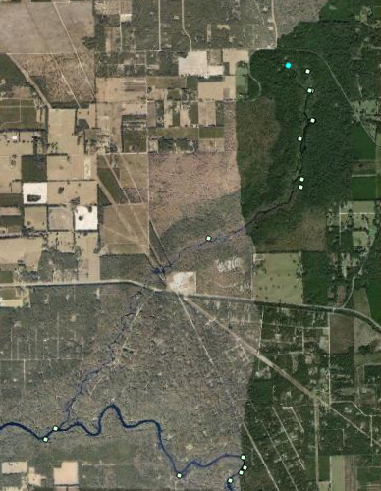
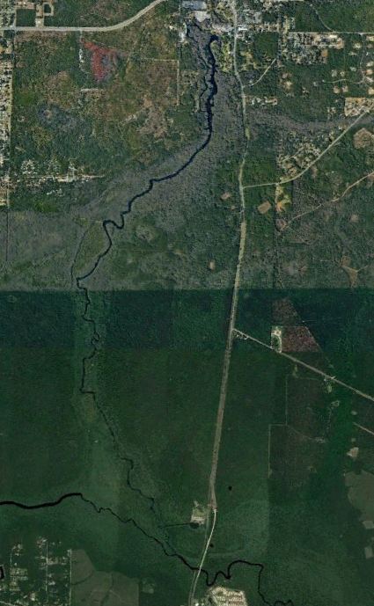
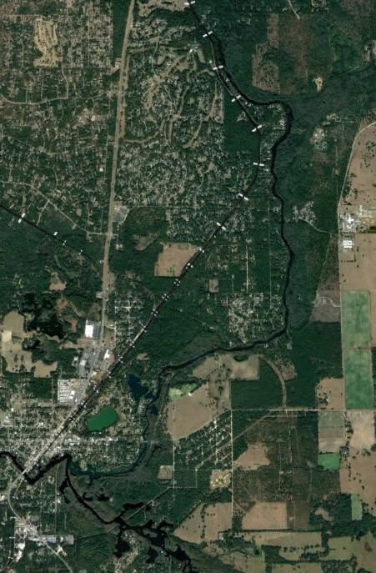
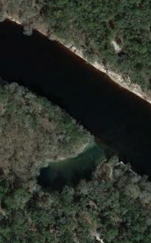
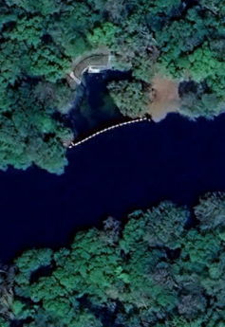
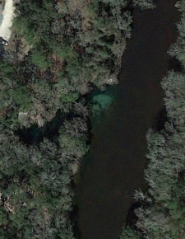




Troy Springs
The longer the spring-run, the more resistance to river reversals
Rum Island Spring, 21m
Madison Blue Spring, 56m
Troy Springs, 84m
Ichetucknee River, 15km
Silver River, 7km
Rainbow River, 9km
Donsky 2023; Hensley & Cohen 2017
Notes:
Now, all springs experience a fluctuations in stage but not all springs experience river reversals.
A springs resistance to a river reversal is a largely dependent 1) its vent elevation and 2) its proximity to its receiving blackwater river (how long its spring run is)
ID, silver, and rainbow river, springs with long runs, all belong to the archetype of outstanding, chemostatic N Fl springs. There waters are super clear, have tons of grass, and are uber productive
but shorter springs that experience a quarter to half the year brown (Troy, Fanning, Madison) tend to have less biodiversity and are murkier

Slide 11

I sought an improved understanding of spring metabolic regimes across a gradient of flood impacts.
Are springs with greater disturbance frequency less productive than less disturbed springs?
H1. Frequently disturbed springs will have less stable metabolic regimes than rarely disturbed springs.
H2. Flood magnitude will be positively correlated with metabolic recovery time and metabolic reduction.
What are the metabolic impacts of spring river-reversals in the absence of bed scour?
H3. Spring-run productivity will decline during floods, despite the absence of bed scour
Notes:
SO, for this project, I sought to explore how disturbance determines spring typology, as well as investigate flood metabolic impacts in the absence of bed scour.
Specifically,…
Are springs with greater disturbance frequency less productive than less disturbed springs?
What are the metabolic impacts of these spring inverted-flood in the absence of bed scour?

Slide 12

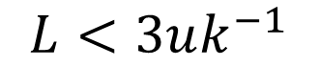
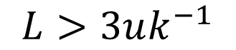
Methods: Modeling Spring-run Metabolism
Two-Station Metabolism
One-Station Metabolism
downstream
$$L>3uk^{−1}$$
$$L<3uk^{−1}$$
upstream
Riley & Dodds et al. 2023; Reichert et al., 2009; Demars et al., 2015
Notes:
To investigate my hypothesis, I need to run a stream metabolism model. There are two ways to do this, two station metabolism and one station metabolism. DEFINE TWO STATION and ONE STATION.
Two station is more accurate, and furthermore appropriate, for modeling spring-run metabolism. However, with this method, it is assumed that the headwaters do not change, nor that flow stops.
To keep it short, if the assumption 3*velocity divided by the reaeration constant was greater than the spring-runs length, I used two station metabolism. So, for any flood event, I used one station metabolism.

Slide 13
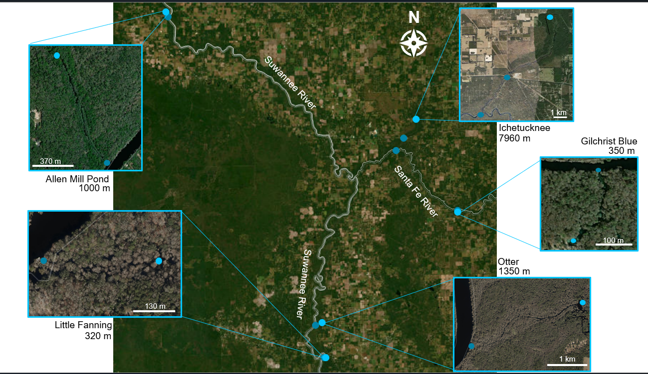
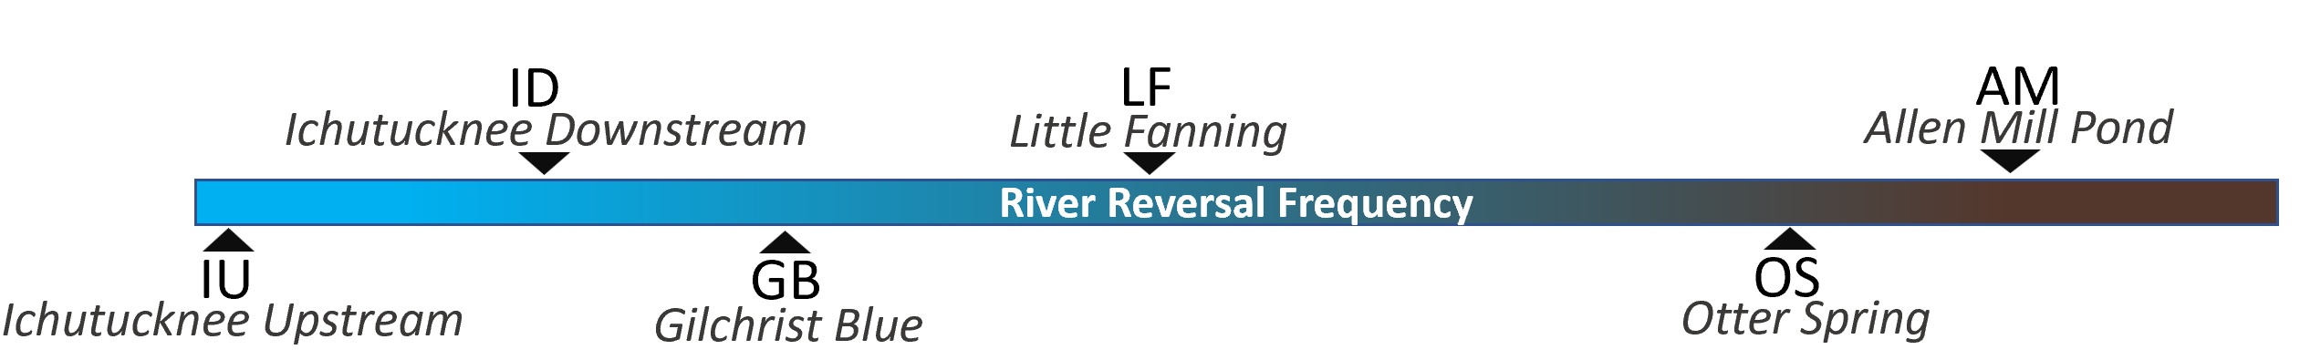
Methods: Study Sites
Copeland & Duffer, 1964;
Khadka et al., 2014
Notes:
For my field methods, I selected 5 spring-runs spanning a river reversal frequency gradient including the iconic Ichetucknee river to the frequently reversing Allen Mill Pond; it spends half of the year brown.

Slide 14
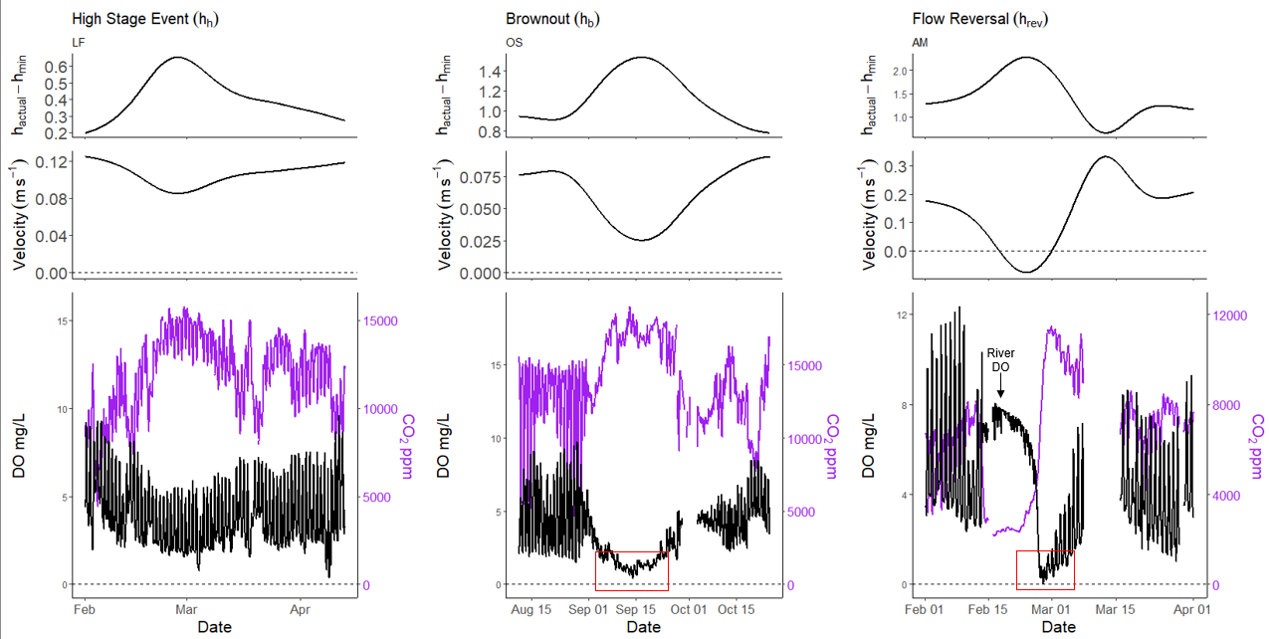
Dissolved oxygen (DO) decreased, and CO2 increased with increasing stage. River reversals caused hypoxia.
Notes:
Before any modeling occurred, an obvious trend emerged. As stage increased, DO decreased and CO2 increased in-tandem.
Furthermore, during a river reversal, the spring-run became hypoxic
The spike in DO during a flow reversal is indicative of a flow reversal. This indicates river water entering the spring and its subsequent metabolic impacts

Slide 15
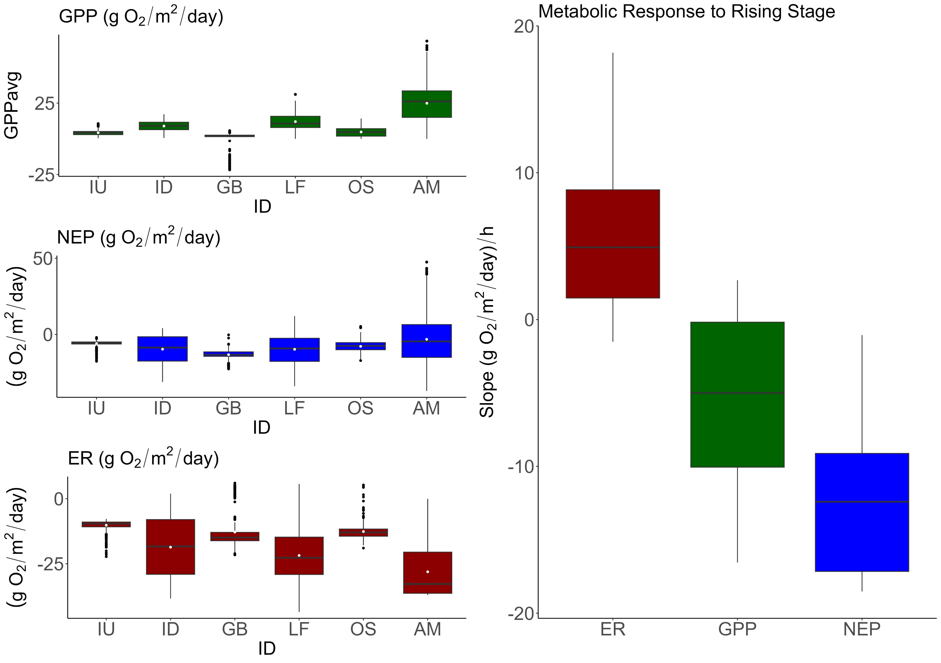
Stage and productivity have a negative relationship, regardless of river influence.
Notes:
Moving on, here are the stream metabolism results across sites including disturbed and non disturbed periods.
Most of my sites were heterotrophic with LF and AM being the exception. They are exceedingly productive.
Across sites, a trend similar to DO’s emerged: as stage increased, GPP decreased, and ER increased. In summary, when stage went up, productivity fell, even for the more chemostatic sites.

Slide 16
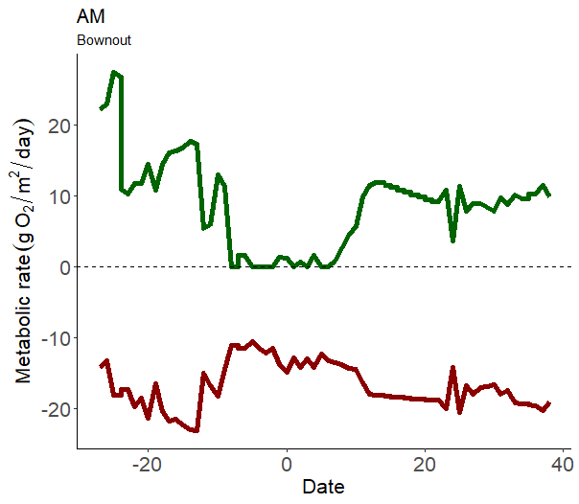

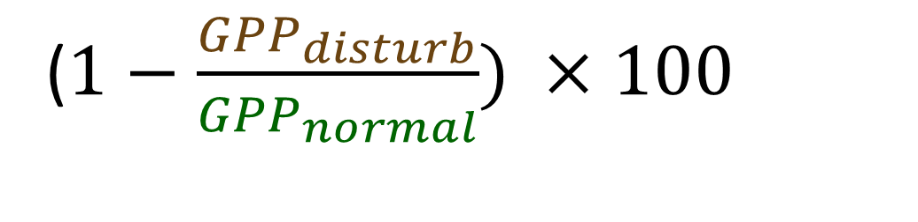
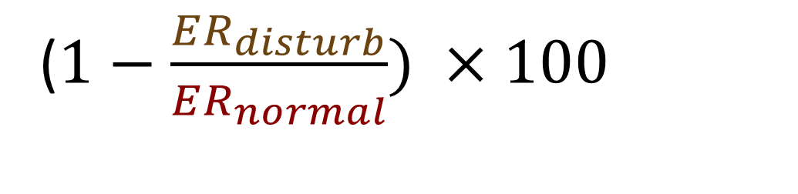
Is disturbance magnitude correlated with spring-run metabolic degradation?
Percent Reduction:
($1−\frac{{GPP}_{disturb}}{{GPP}_{normal}}) ×100$
($1−\frac{ER_{disturb}}{ER_{normal}}) ×100$
Cite AJ
Notes:
Zooming in, I wanted to explore whether the severity of disturbance impacts was dependent on spring disturbance magnitude.
Using simple percent-reduction equations

Slide 17
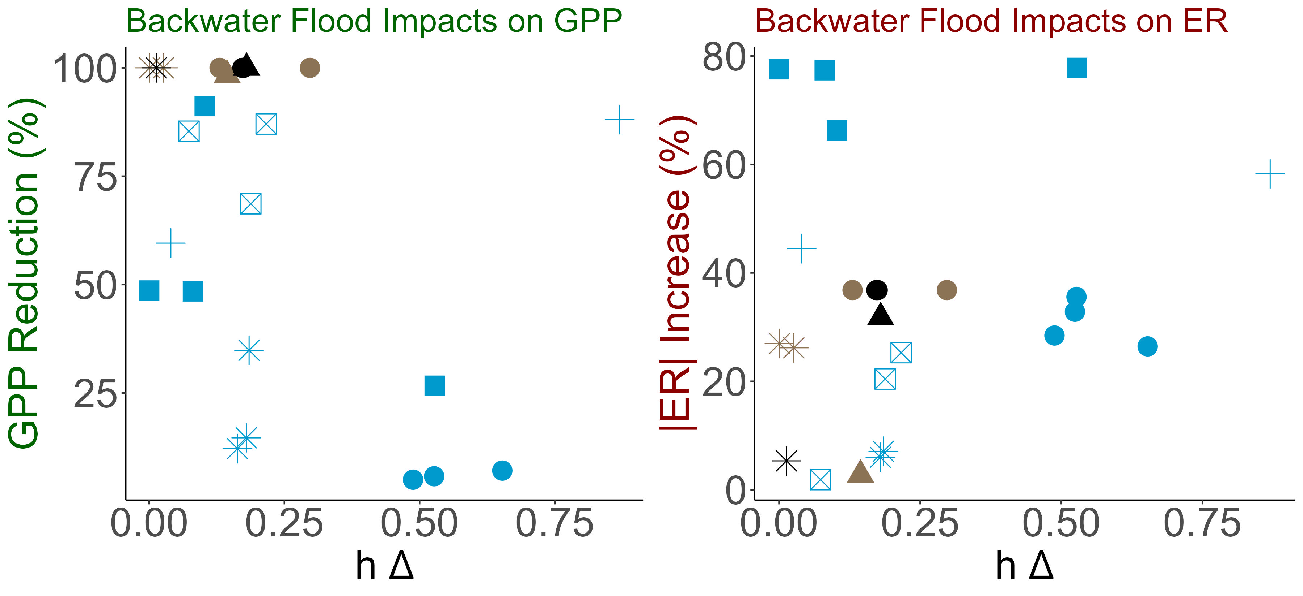

, Spring floods did not result in proportionally larger ER increases.
, River reversals drove GPP to 0, regardless of disturbance magnitude.
ER increases
ER increases
GPP decreases
GPP decreases\
Acuna et al., 2004; Reisinger et al., 2017
Notes:
In this figure, the x axis represents the difference between the stage minimum and the flood stage.
On the y axis I have the percent reduction
The stand-out result was once the water become brown, GPP was diminished, regardless of flood severity and emphasized how light availability is strongly linked to spring productivity
For high stage events, GPP decreased with each occurrence but there was no obvious pattern
ER did not have a proportional increase with increasing disturbance magnitude but none the less saw a 63% average increase.

Slide 18
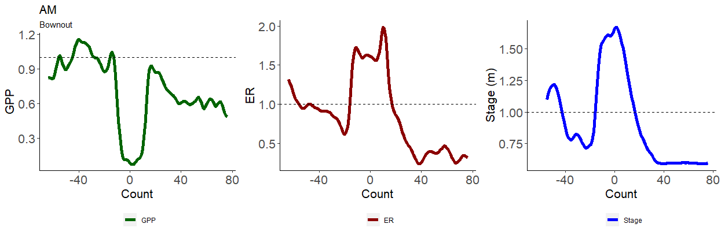
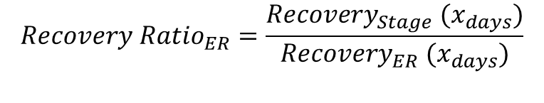
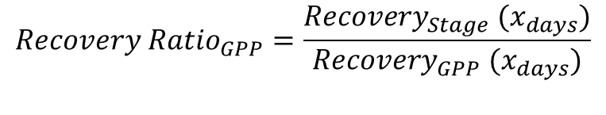
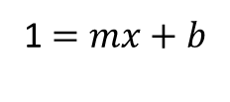
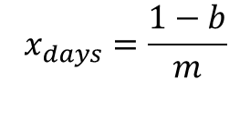
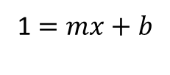
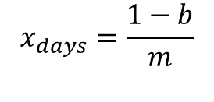
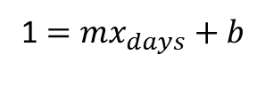
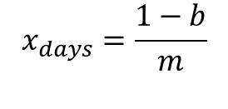
Is disturbance magnitude correlated with spring-run recovery?
$$x_{days}=\frac{1−b}{m}$$
$$x_{days}=\frac{1−b}{m}$$
$$x_{days}=\frac{1−b}{m}$$
1 $=mx_{days}+b$
1 $=mx+b$
1 $=mx+b$
$$Recovery Ratio_{GPP}=\frac{Recovery_{Stage} (x_{days})}{Recovery_{GPP} (x_{days})}$$
$$Recovery Ratio_{ER}=\frac{Recovery_{Stage} (x_{days})}{Recovery_{ER} (x_{days})}$$
Recover Ratio > 1; Metabolism recovered quicker.
Recover Ratio < 1; Stage recovered quicker .
Reisinger et a. 2017.
Notes:
Continuing this thread, a spring’s recovery dependent on disturbance regime or disturbance magnitude, or both?
For this, I fitted a linear regression between the height of the disturbance and when the spring-run recovered
I extracted this linear relationship to estimate recovery time
I divided GPP and ER recovery by stage’s recovery and called these ratios, recovery ratios

Slide 19
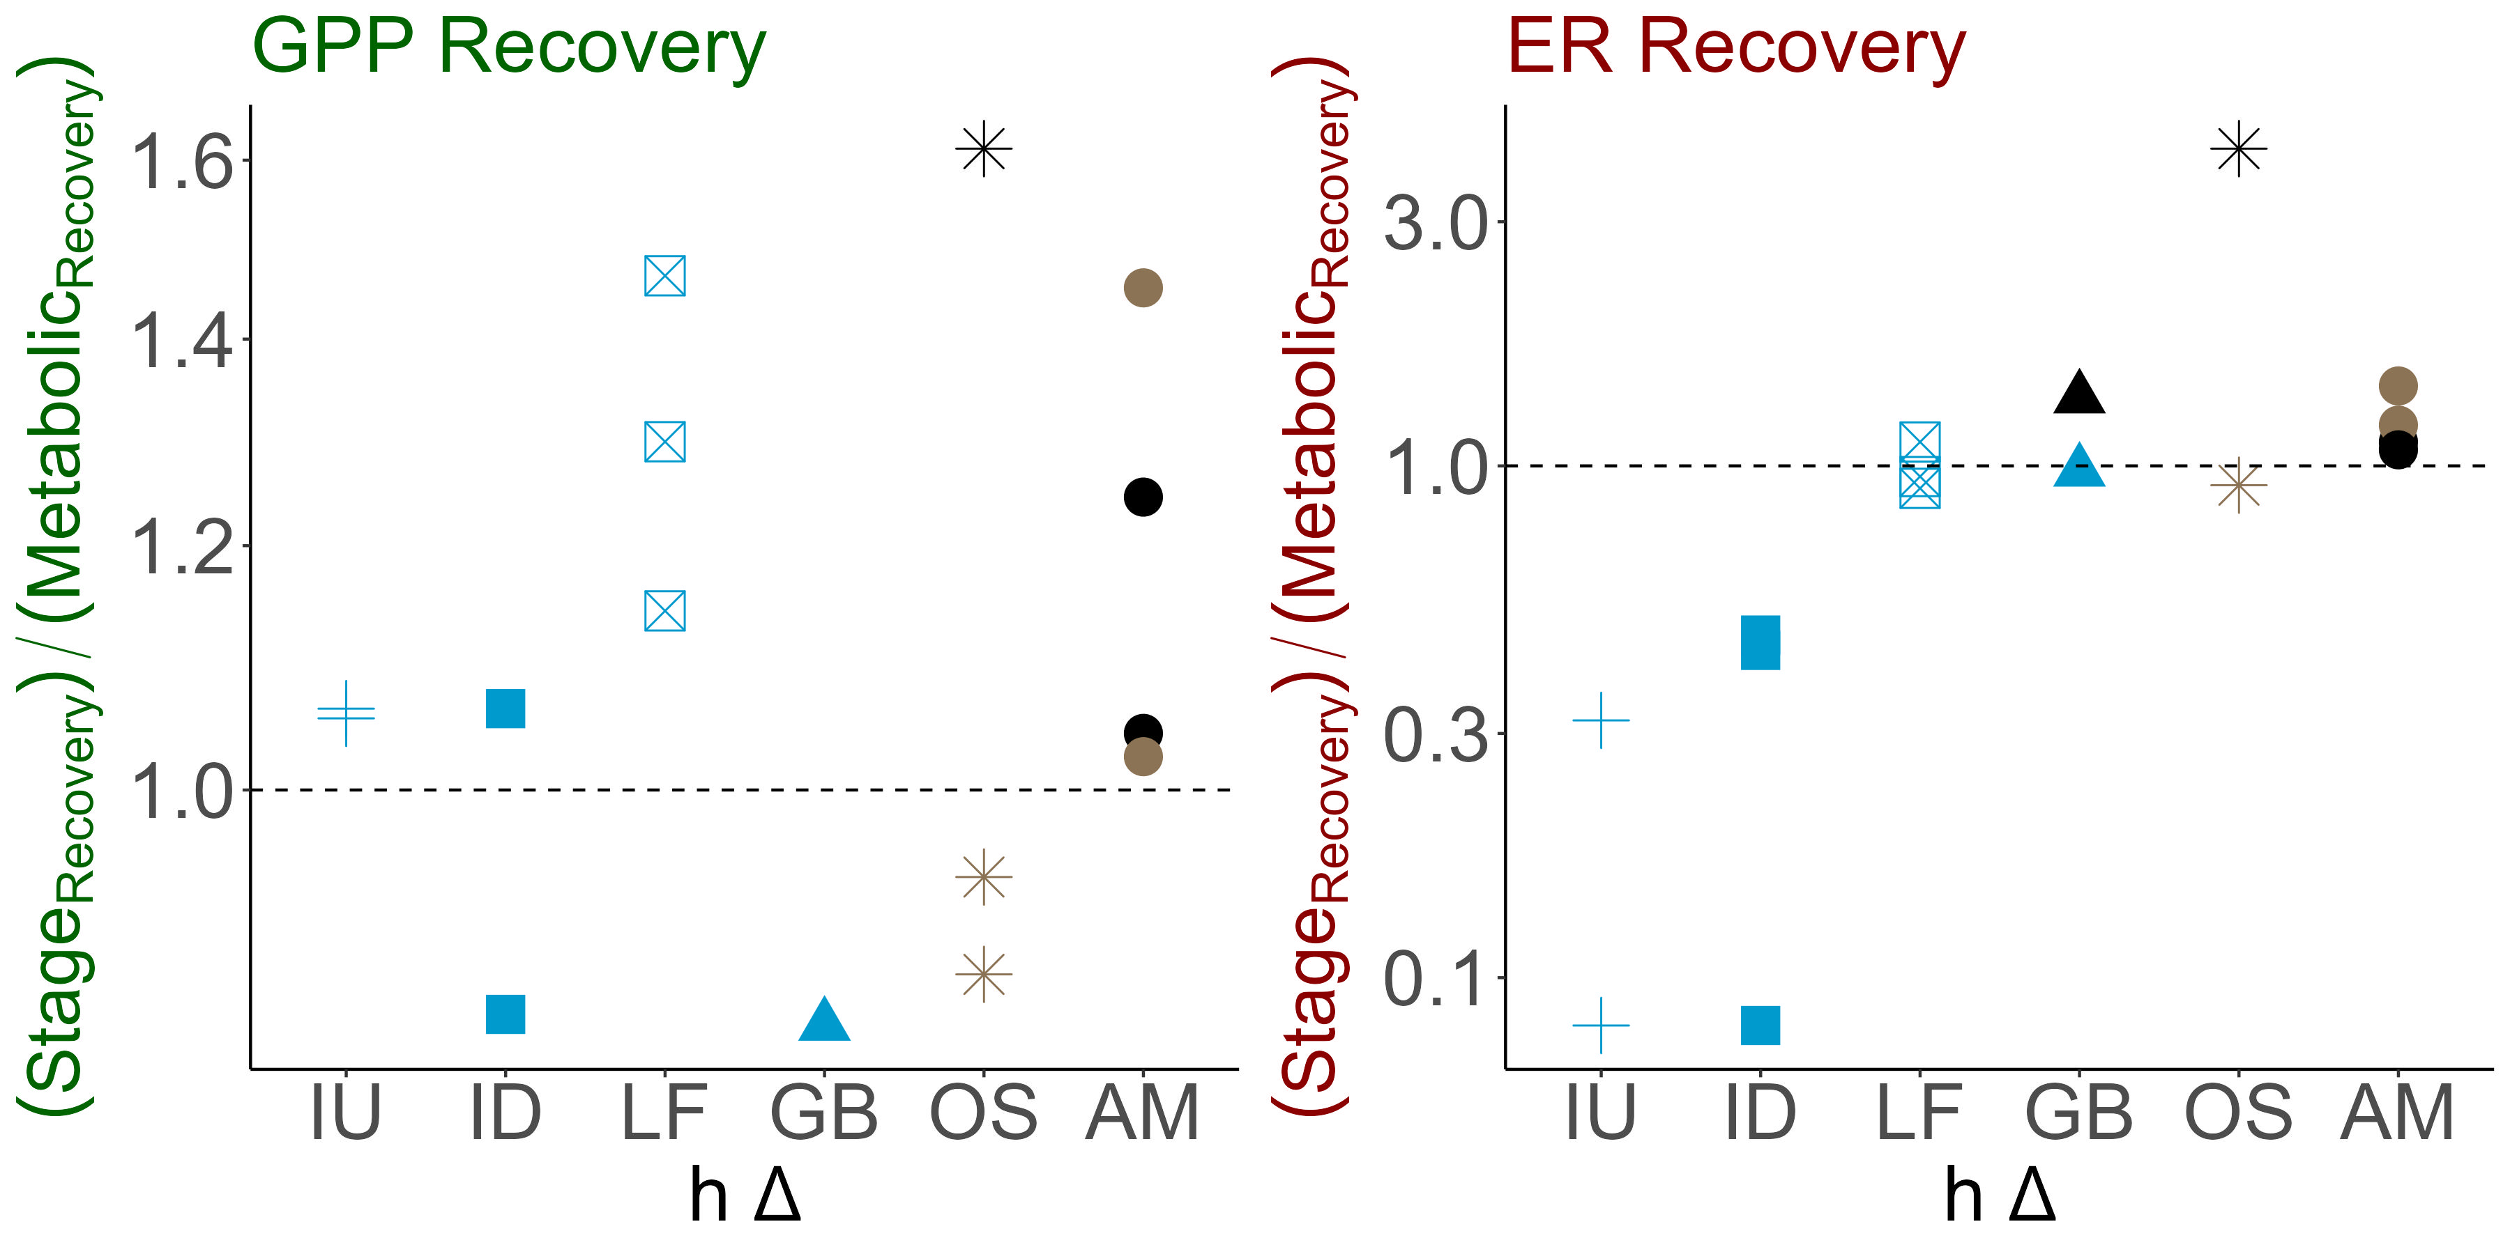
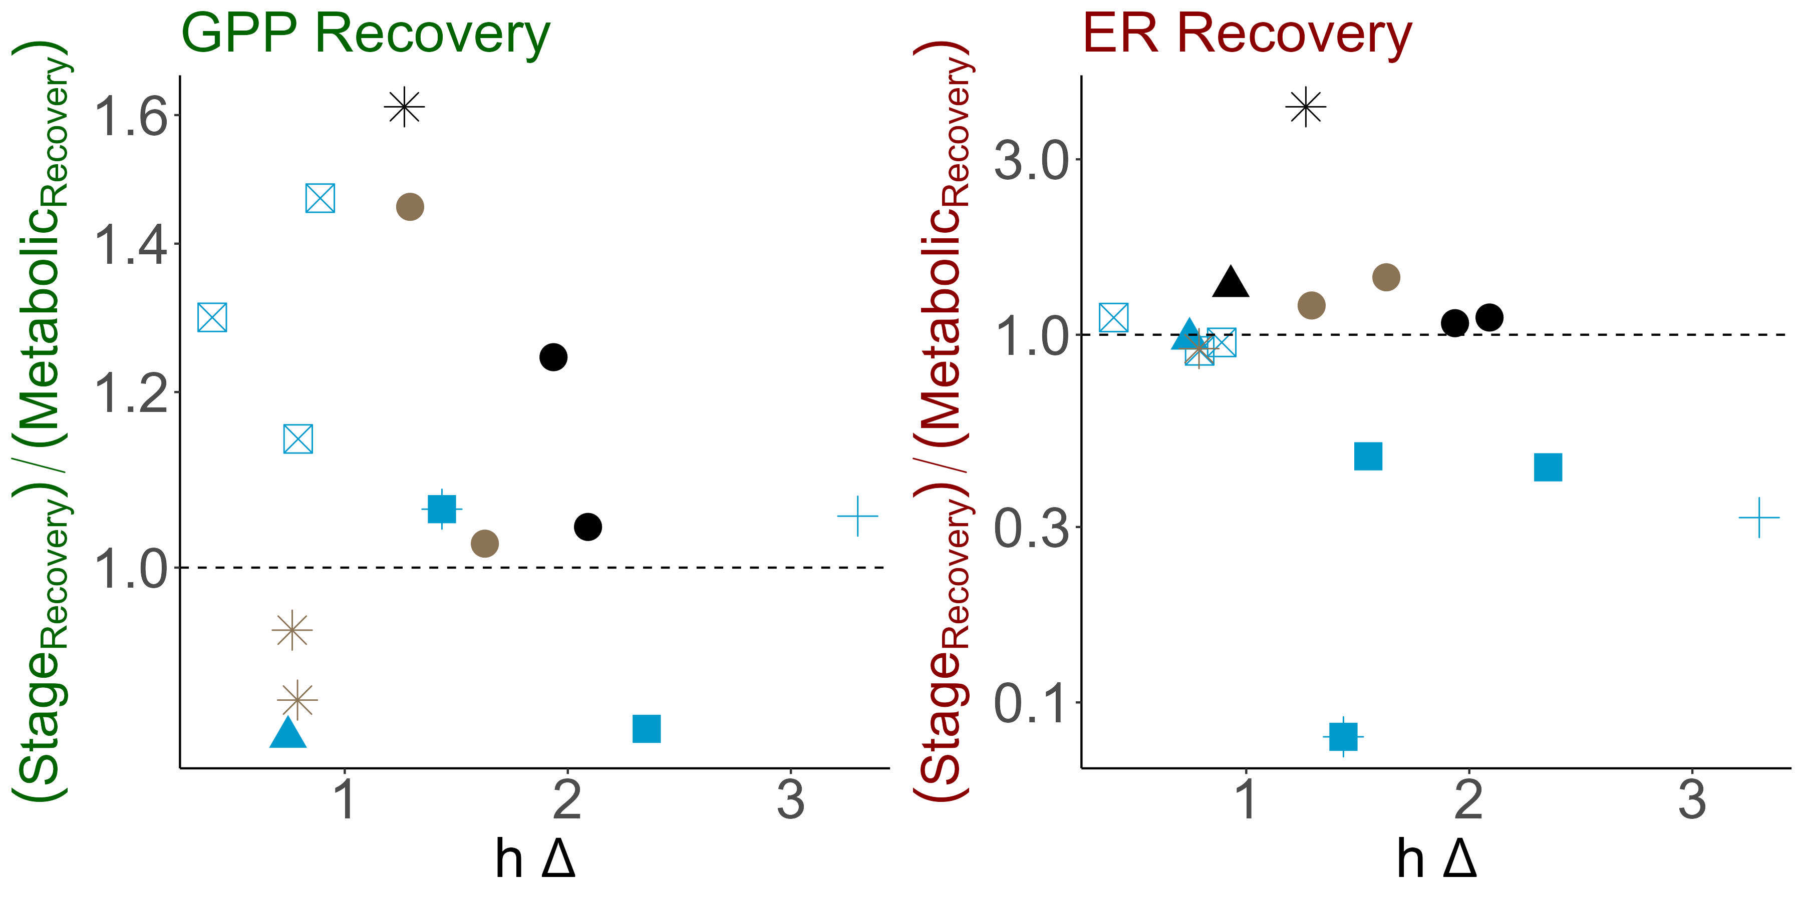
Spring metabolism recovered along-side stage
Notes:
As you can see, there is no obvious trend between disturbance magnitude and recovery
However, for most the sites, GPP and ER recovered along side or quicker than stage, especially GPP
A similar story can be seen with disturbance regime. There is a slight positive trend with disturbance frequency and ER recovery however, it was insignificant
Overall, indicating resilience to these floods

Slide 20
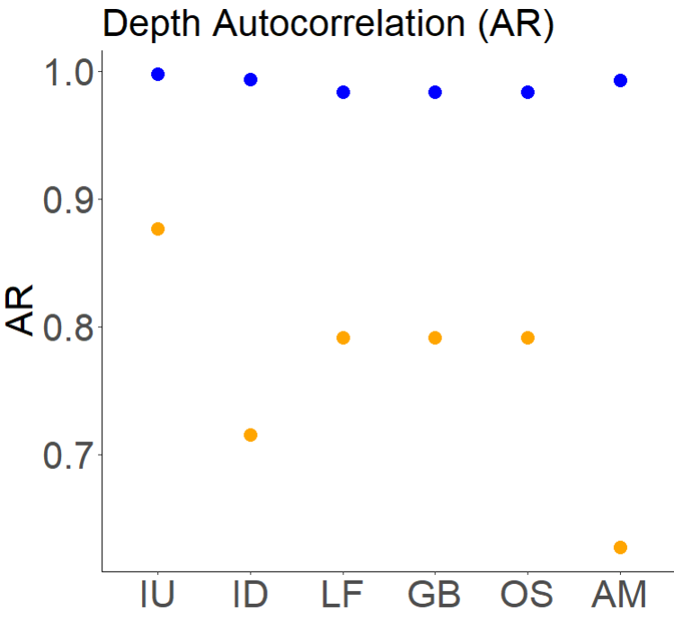
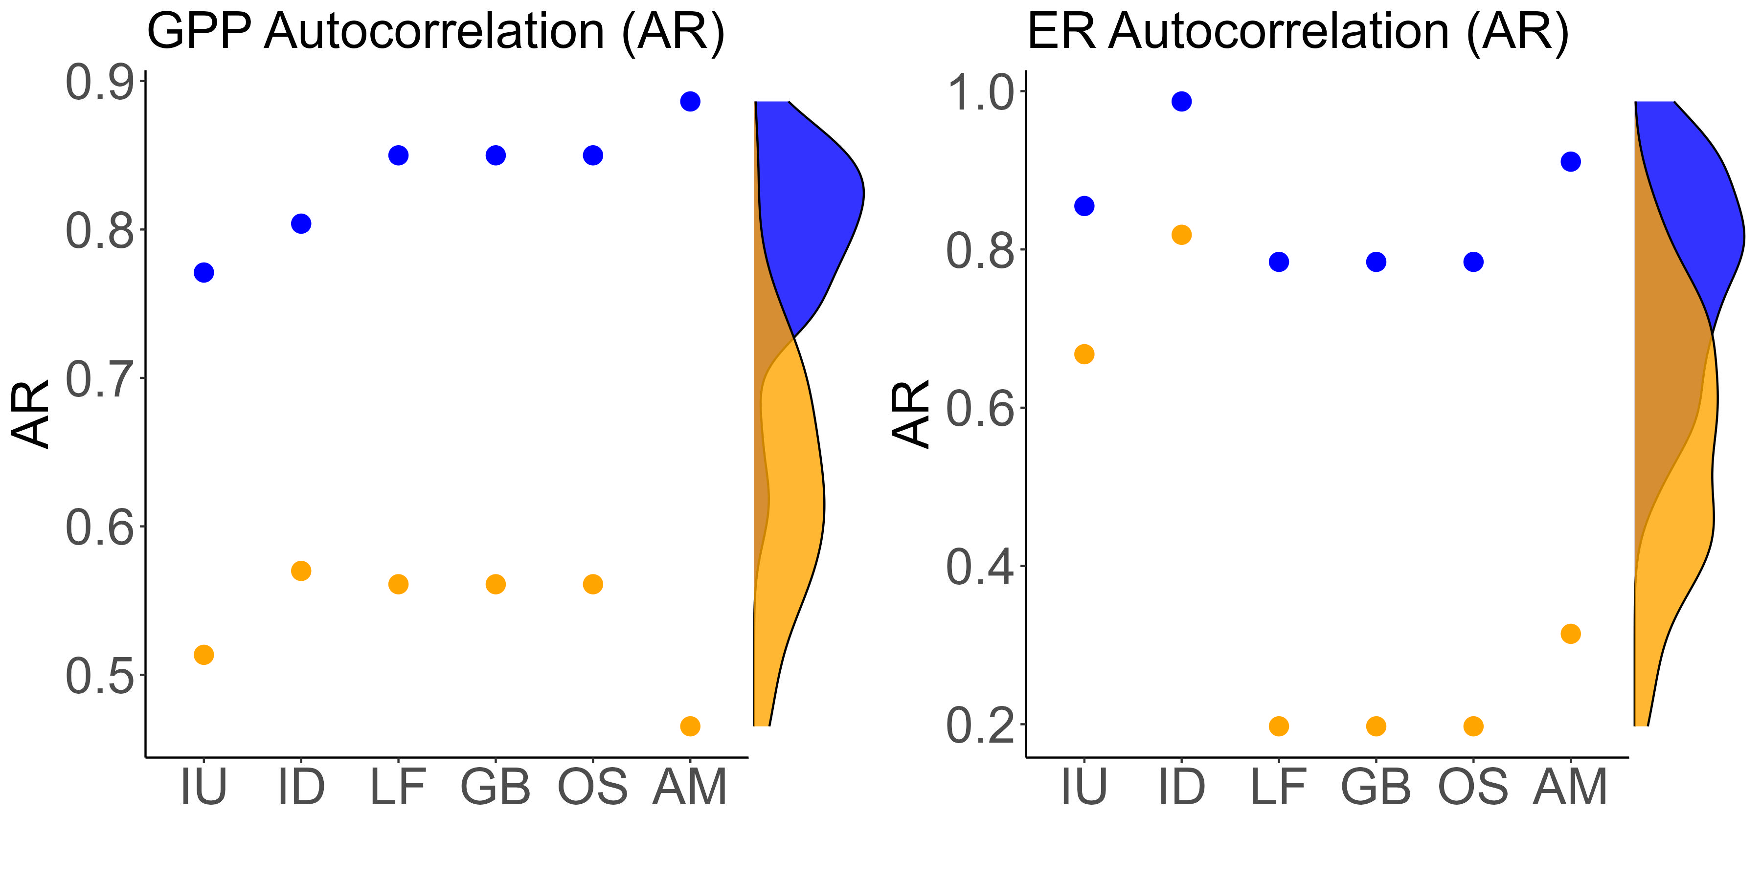

Less disturbed spring-runs had more stable metabolic regimes than more disturbed spring-runs.
Notes:
Lastly, With these results in mind, I wanted to investigate whether more disturbed springs were less chemostatic than less disturbed springs
Here I display the autocorrelation for each of my sites. The density data on the site is from Appling et al. 2020
My site followed the expected pattern with less disturbed sites having greater autocorrelation than more disturbed sites.
However, AR1 for GPP was unexpected with more chemostatic sites displaying weaker autocorrelations than my more disturbed sites. Specifically, IU which is the farthest from its blackwater river.

Slide 21


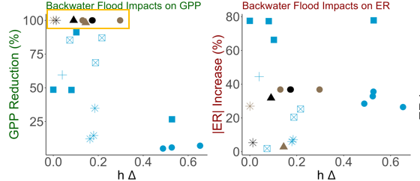
Bernhardt et al. 2018; Mullholand et al. 2001; Hensley et al. 2017; Uehlinger et al. 2000; Donsky 2023
Indicating light availability is a major factor in spring-metabolism
Site: OS
Stage and productivity have a negative relationship, regardless of river influence.
, Spring floods did not result in proportional ER increases, but none the less an increase.
, River reversals drove GPP to 0, regardless of disturbance magnitude.
Site: OS
Notes:
This paints a unique picture of spring-run metabolic regime
Increased stage was significantly correlated with a decrease in productivity. However, once light was extinguished by the river, GPP became 0
Indicating light availability is a major factor in spring metabolism
There swapping of headwaters is less important, once light is attenuated, there the spring-run will have a metabolic response.

Slide 22
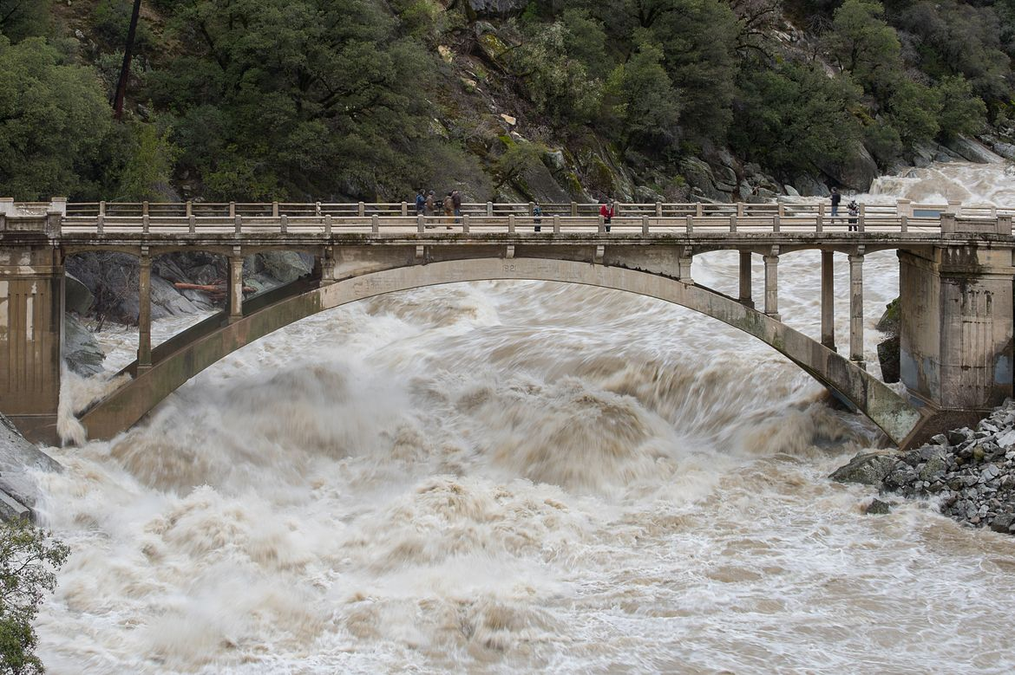

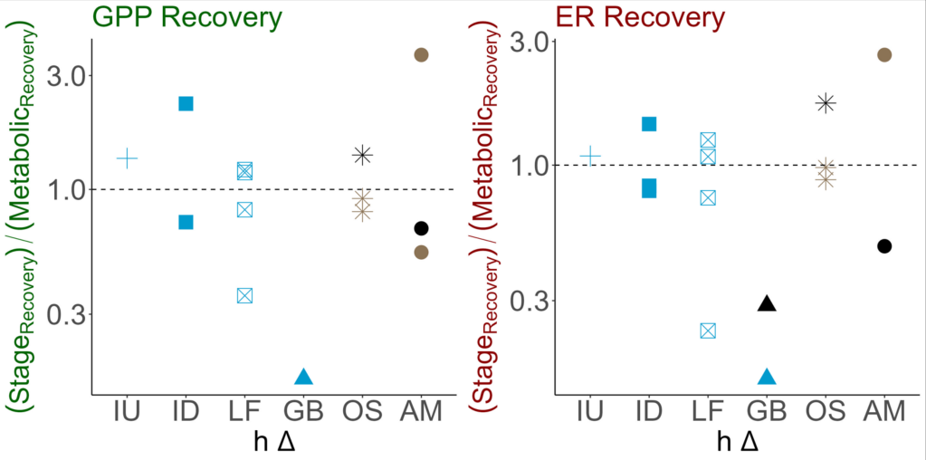
Spring metabolism recovered more quickly or as quickly as stage
Light availability determines productivity, but the retention of the benthos decides recovery
Site: ID
Notes:
Yet, spring metabolism recovered along side stage, indicating that although light influence the metabolic response, its bed scour determines recovery time
Since the spring-runs retain their benthos, once light returns, they once again can photosynthesize resulting in a quick recovery time,

Slide 23
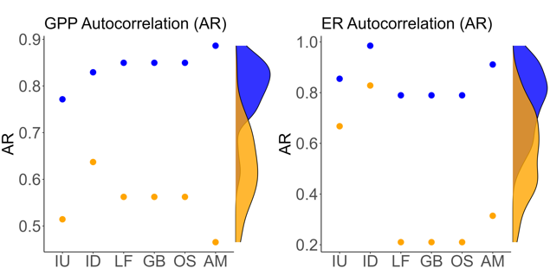

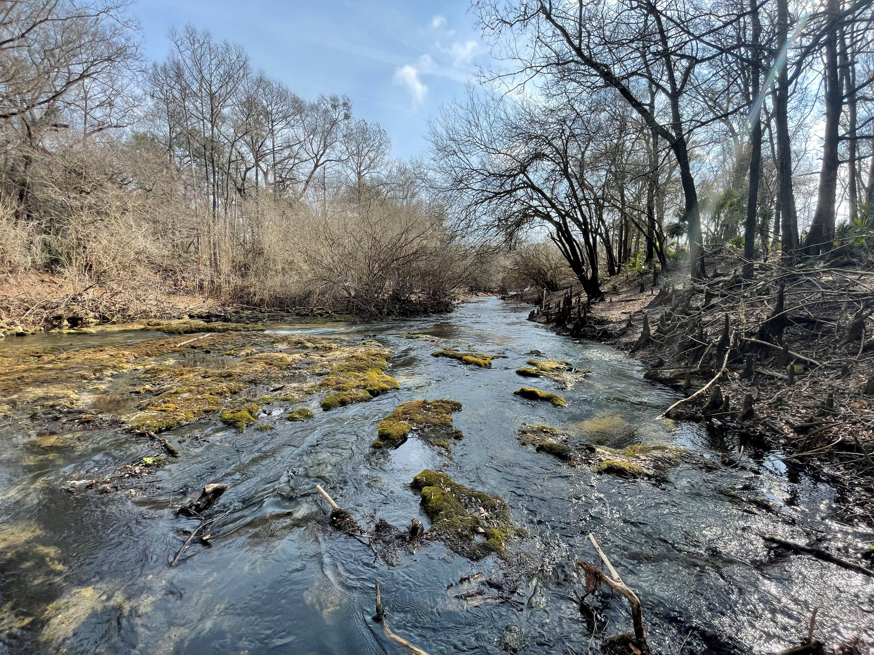

Overall, less disturbed spring-runs had more stable metabolic regimes than more disturbed spring-runs.
Ichetucknee Headspring
Allen Mill Pond
Rum Springs
Metabolic Stability
Notes:
And lastly, I found North Florida spring-runs span a gradient of flow regimes dependent on their disturbance regime
With some springs truly being some-what chemostatic and some…not

Slide 24



































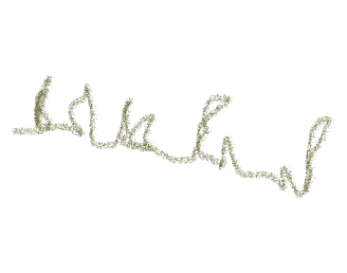
































… and as such, disturbance is a key factor in spring-run regime and function
CO₂
CO₂
CO₂
CO₂
Thank you!
samanthahowley@ufl.edu
CO₂
CO₂
CO₂
CO₂
CO₂
CO₂
CO₂
CO₂
Notes:
And as such, disturbance is a key factor in spring-run metabolic regime and function, like any other flowing waters
Thank you!

Slide 25
Appendix

Slide 26
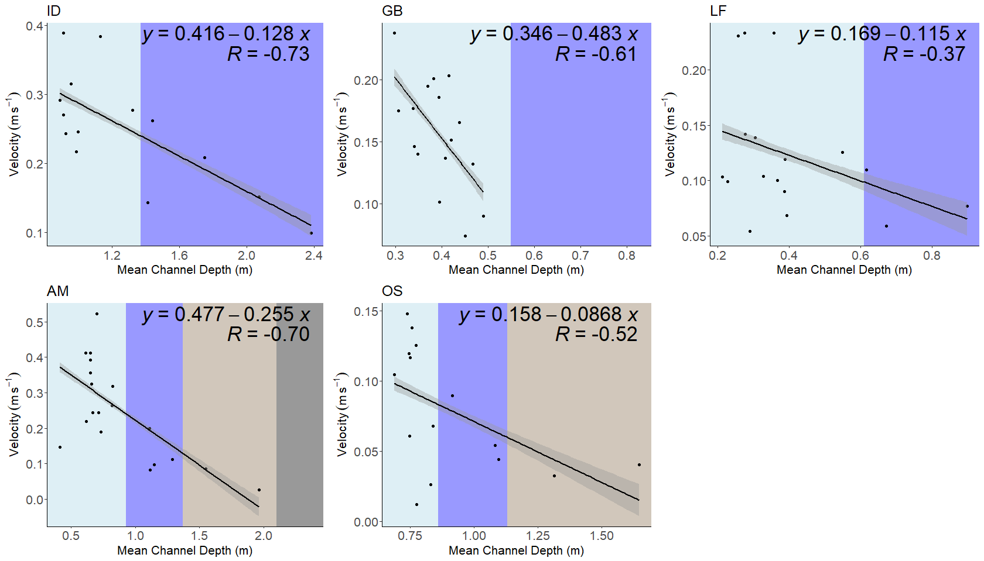


Slide 27
